Slide 1
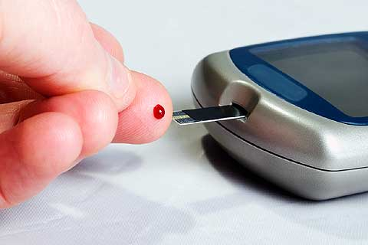
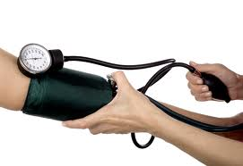

Neurological Disorders
Lesson 5.7
Is addiction a chronic disease?

Slide 2
Do Now:
Define the term disease.
Categorize the following diseases as acute or chronic.
High blood pressure
Type I diabetes
Strep throat
Common cold
Chickenpox
HIV
Depression
Meningitis
Pneumonia
Asthma
Arthritis
Cancer
Ear infection
Epilepsy
Multiple sclerosis
Addiction

Slide 3
What is a disease?
Abnormal condition affecting the body

Slide 4
Acute vs Chronic
How would you describe acute diseases?
  Short duration but may be very intense and have a rapid onset.
How would you describe chronic diseases?
  Persist over a long period of time.

Slide 5
Acute Conditions
Which of the “Do Now” diseases are acute?
  Short duration.
Strep throat
Common cold
Chickenpox
Meningitis
Pneumonia
Ear infection

Slide 6
Chronic Conditions
Which of the “Do Now” disease are chronic?
  Persist for a long period of time.
High blood pressure
Type I diabetes
HIV
Depression
Asthma
Arthritis
Cancer
Epilepsy
Multiple sclerosis
Addiction

Slide 7
Why is addiction considered to be a chronic disease?
Addiction causes changes in the brain.
Addiction is the compulsive, non-voluntary use of drugs.
People are never completely cured of their addictions.

Slide 8
Dealing with Chronic Disease

Slide 9
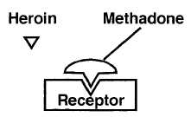
Ruth’s Story

Slide 10

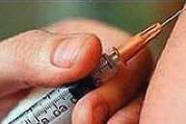
Mike’s Story

Slide 11
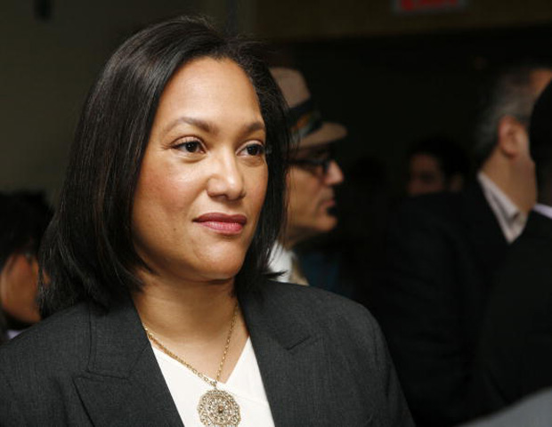
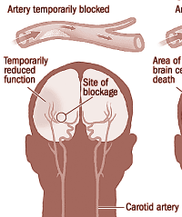
Carol’s Story

Slide 12



Laura’s Story

Slide 13
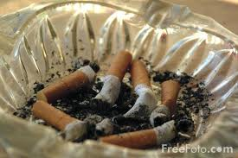


Lenny’s Story

Slide 14
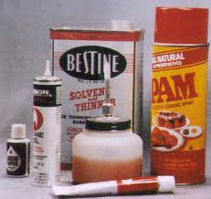

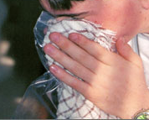
Daniel’s Story

Slide 15
Comparing the Cases
Who was cured of their disease? What is the difference between treatment and cure?
How are the treatments for the different diseases similar? How are they different?
How were the actions and strategies that the individuals took to deal with their diseases similar? How were they different?

Slide 16
Addiction is a Chronic Disease
Drug addiction results in chronic effects on brain activity, just as heart disease results in chronic effects on heart activity.
Brain
Healthy brain
Addicted brain
Heart
Healthy heart
Diseased heart

Slide 17
Homework
You are an advisor to a government agency that needs to decide whether or not insurance companies should be required to cover treatment for addiction.
Write a paragraph to help the agency make the right choice.
Nova - Addiction

